Slide 1
Dendrogram Overview

Slide 2
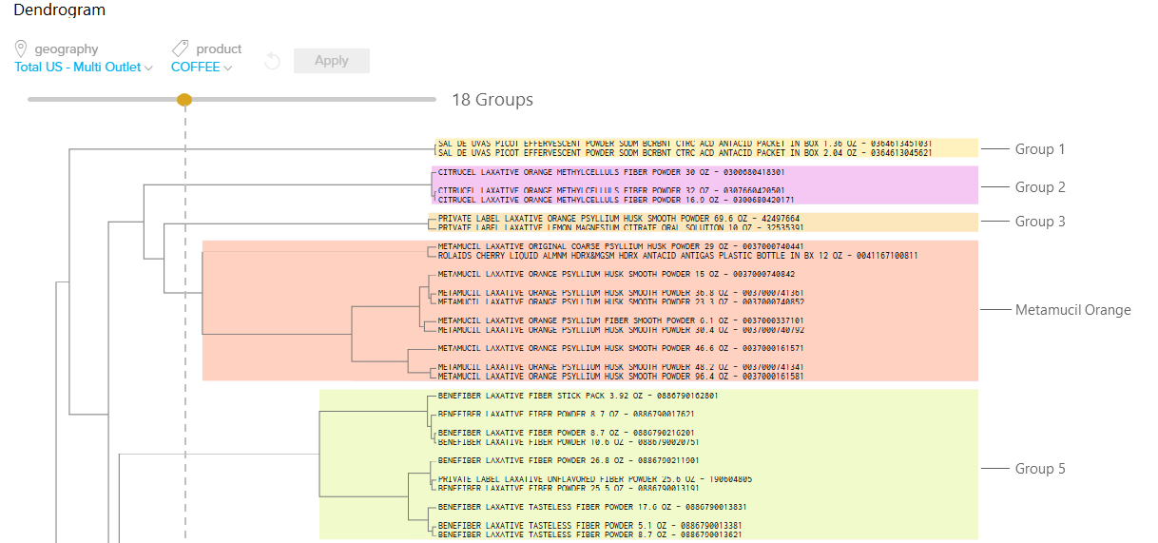
What is a Dendrogram??
A Dendrogram is a diagram that shows the hierarchical relationship between products.
The lower the link between groups of items, the more closely they are related/substitutable
Purpose: Insights to Action
High level breaks in the Dendrogram can be used to inform Macro level Merchandising
Low level product groupings can be used to validate/inform switching groups
Similar items
Similar items
Similar items
Similar items
Similar items

Slide 3
Dendrogram Methodology
All Walgreens Balance Reward Cards data included
Last 52 weeks purchase behavior
Items purchased in the same basket are excluded from the analysis, which narrows the focus of the output to identify true substitutability
Competitive market customer behavior is not included in analysis
1. Identify transaction pairs
3. Generate aggregate affinity between items
4. Build the affinity matrix
2. Build matrix of switching
5. Populate the Customer Decision Tree
Within logical switching,
substitutable items:

Slide 4
Dendrogram Timing & Best Practice Approach/Application
Timing
Macro Customer Decision Trees updated once a year based on reset schedules, typically available 30 weeks pre-reset (Schedule to be posted on Welcome Page in Unify)
Best Practices
Analyze from a top-down approach to yield ~20 product groupings for optimal results
All items with sales are included in Dendrogram. Low volume items should be omitted from consideration when naming the product levels as they can fall in illogical locations
Use the 80/20 rule when naming item groups
Dendrograms can be created above opstudy level, however, it is not recommended due to the overlap of complementary items
Similarly, it is not recommended to include disparate product groups that do not logically have switching or interactions (e.g., Car Air Freshener and Anti Freeze)

Slide 5
The Item analysis (Dendrogram) is based on panelist buying behavior to determine items that should cluster together
Step 1 : For Every Household, actual UPC level buying behavior across time period is considered to identify UPCs that are substitutes based on affiliations (high affiliations which are over 100).
Step 2 : Affiliations between two items is the measure of the switching between these two items relative to their share. Higher the switching, higher is the affiliation index thus indicating substitutability.
Step 3 : We use this affiliation Index by treating it as a distance measure for clustering. Two items / UPCs that highest affiliation will have the smallest distance between them and will cluster together.
Step 4 : The Algorithm then starts combining other UPCs based on distance and generate the node structure based on aggregating all the lower level groups/clusters
A few slides that explains based on which measure is the dedndrogram built on. The dendrogram is employong clustering that is clear no need anything but is not clear on What values/metrics is the clustering working off.

Slide 6
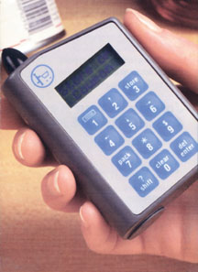
Step 1. Construct the Input Database
For each IRI Panel household, make a chronological list of each category SKU purchased.
Category purchases over the past 52 or 104 weeks
P
P
Household 1 -
P
7
P
C
C
M
C
P
M
Household 2 -
C
S
C
C
M
C
7
C
C
S
S
Household 3 -
P
S
S
M
S
S
7
M
S
M
M
S
S
Household 4 -
P
P
P
C
C
P
C
P
P
C
C
C
P

Slide 7
Step 1. Calculate the Interaction from all purchases… (cntd.)
Purchase pairs are calculated to measure affiliations among the items. Items which show high amount of switching will show a high level of affiliation.
Category purchases over the past 52 or 104 weeks
Older
purchase
Most recent purchase
Household 1 -
P
7
P
C
C
M
P
C
P
M
Household 2 -
C
S
C
C
M
C
7
C
C
S
S
Household 3 -
P
S
S
M
S
S
7
M
S
M
M
S
S
Household 4 -
P
P
P
C
C
P
C
P
P
C
C
C
P

Slide 8
Step 2 : Based on an affiliation index . . . Higher the affiliation, higher is the substitutability
Purchase pairs are then converted to Affiliation Index based on switching between items vs. the share of the item
Brand
Description | Pepsi | Coke | Sprite | Mt. Dew | 7 up
Pepsi |  | 115 | 86 | 70 | 88
Coke | 115 |  | 94 | 95 | 91
Sprite | 86 | 94 |  | 117 | 135
Mt. Dew | 70 | 95 | 117 |  | 139
7 up | 88 | 91 | 135 | 139
Brand
99% significance level

Slide 9
Step 3 : Affiliation Indices are transformed into distances… smaller the distance , higher is the similarity
Brand
Description | Pepsi | Coke | Sprite | Mt. Dew | 7 up
Pepsi |  | 115 | 86 | 70 | 88
Coke | 115 |  | 94 | 95 | 91
Sprite | 86 | 94 |  | 117 | 135
Mt. Dew | 70 | 95 | 117 |  | 139
7 up | 88 | 91 | 135 | 139
Brand
Coke, Pepsi have the smallest distance with each other.
Similarly, Mt. Dew, Sprite and 7 Up have smallest distance with each other
Description | Pepsi | Coke | Sprite | Mt. Dew | 7 up
Pepsi |  | 0.009 | 0.012 | 0.014 | 0.011
Coke | 0.009 |  | 0.011 | 0.011 | 0.011
Sprite | 0.012 | 0.011 |  | 0.009 | 0.0075
Mt. Dew | 0.014 | 0.011 | 0.009 |  | 0.0072
7 up | 0.011 | 0.011 | 0.0075 | 0.0072

Slide 10
Step 4 : Use the distances to then cluster items based on smallest to largest distances
Dendrogram
Clustering process
7 up and Mt. Dew is combined first as this has the smallest distance.
Coke and Pepsi are combined together as they have the smallest distance
Similarly Sprite is combined with Mr. Dew and 7 up as this has the smallest distance with this group vs. the Coke – Pepsi group.
This process is called as “Agglomerative hierarchical clustering”
Coke
Pepsi
Sprite
Mt. Dew
7 up

Slide 11
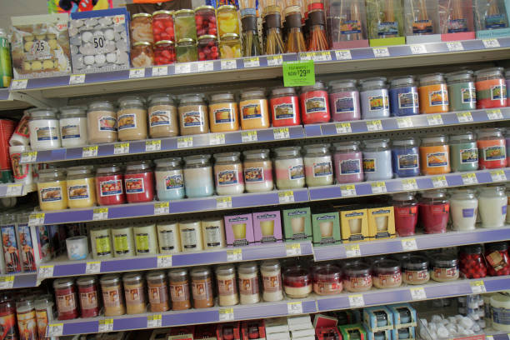
Step-by-Step Example Dendrogram (Item Analysis): Candles OpStudy
Candles

Slide 12
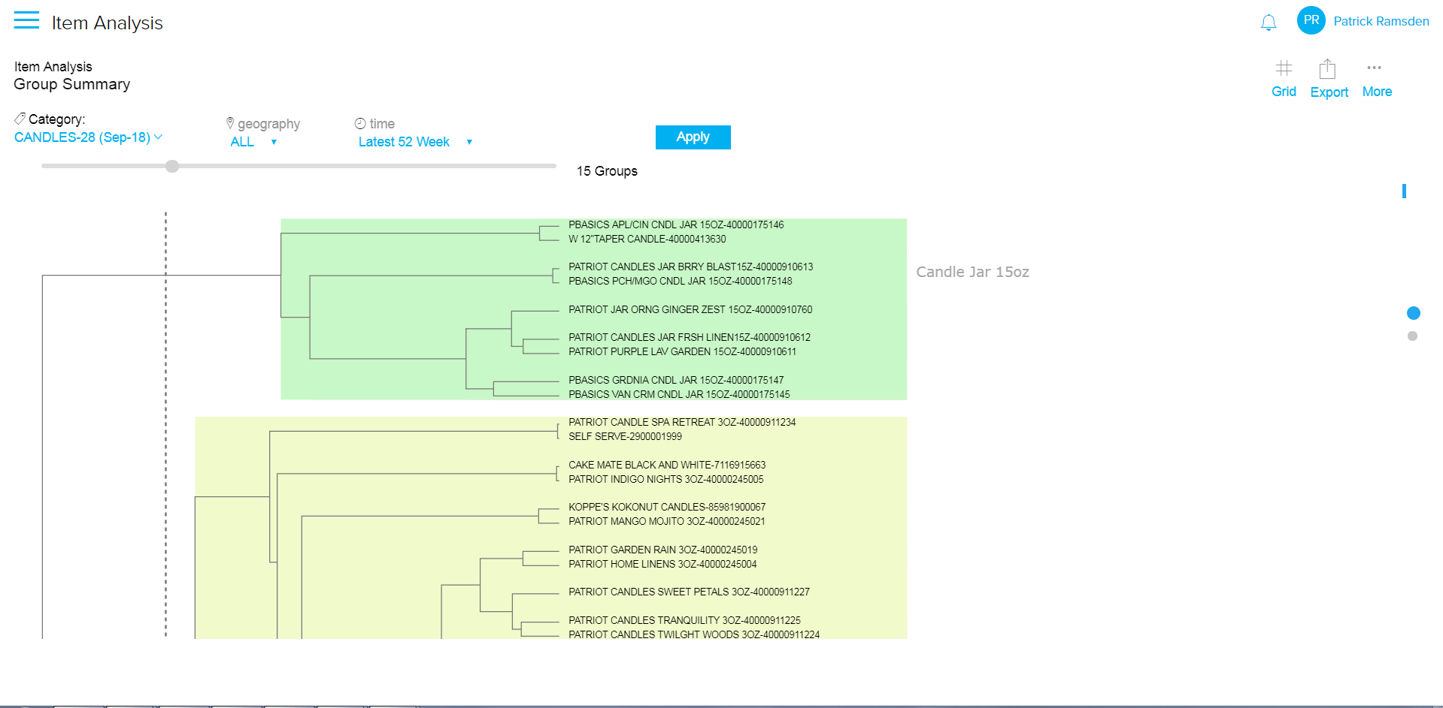
Use Case of a high-level decision tree: Candles Evaluating and Exporting the product groupings…
Review and name significant product groupings (those items swapped by customers); in most cases ~20 groups will meet the need
Export* the chart view of the named groupings into Excel for a one-page visualization
2.
*Export Troubleshooting: If the export does not download, you may need to update your Chrome settings so that the Dendrogram URL is added to “Allow” under Pop-Up Blocker. Technical assistance is available at Technical.Support@IRIWorldwide.com.

Slide 13
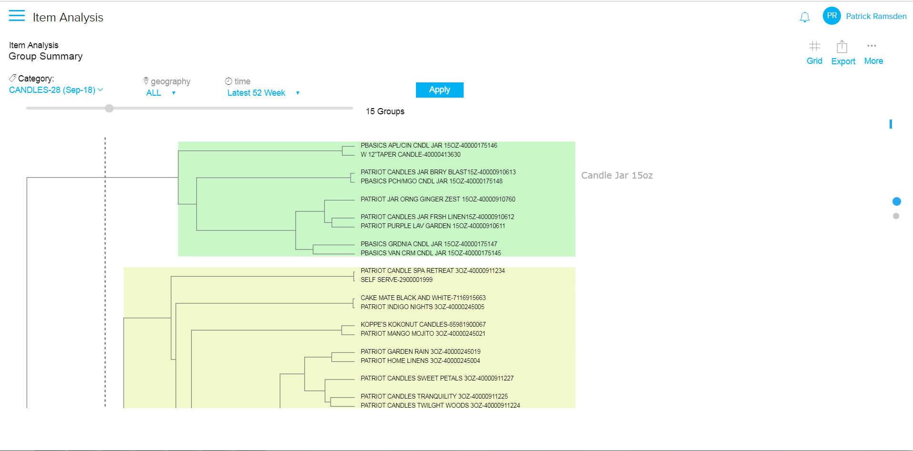
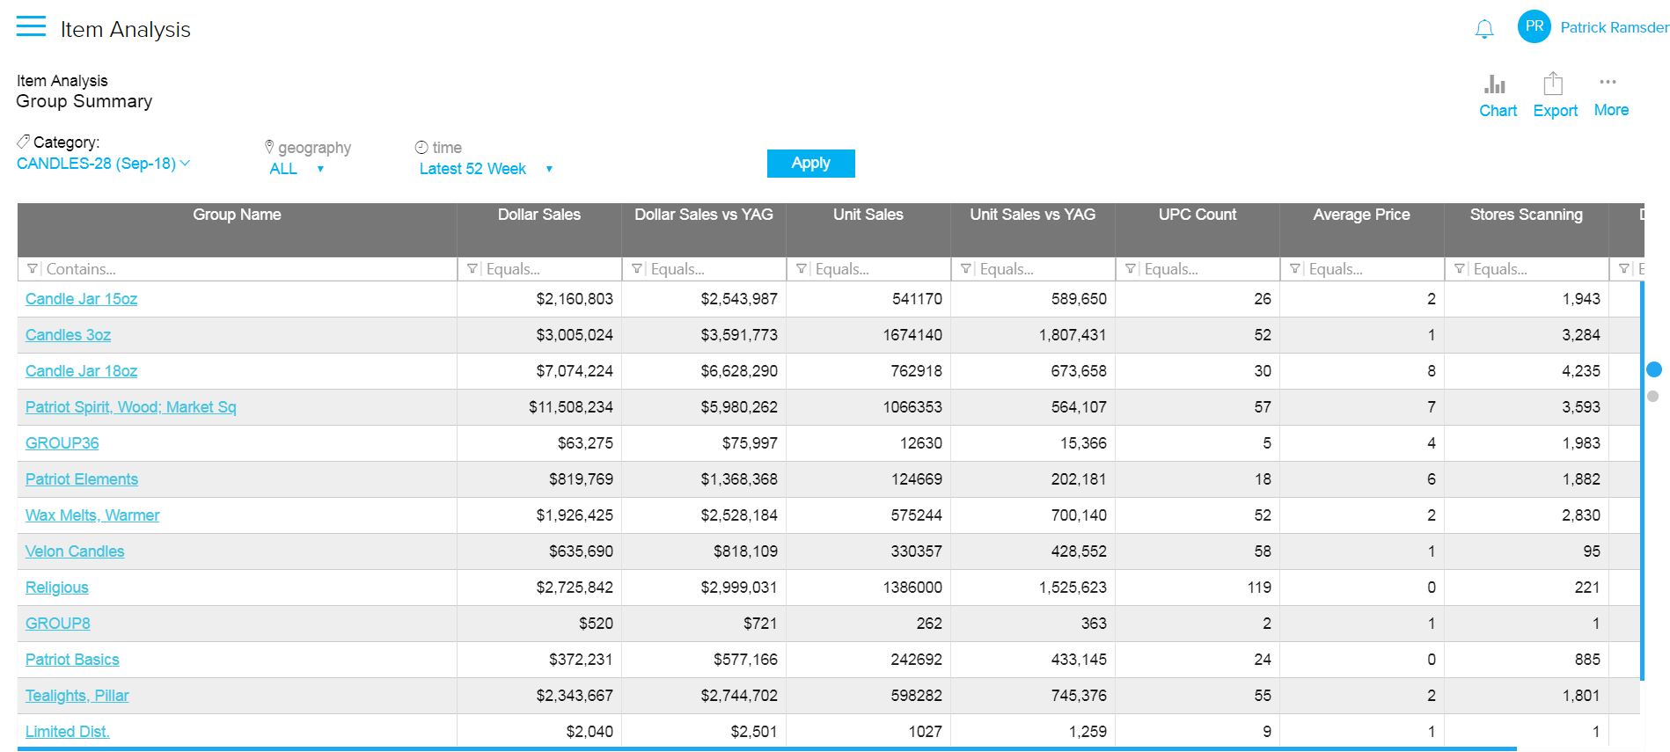
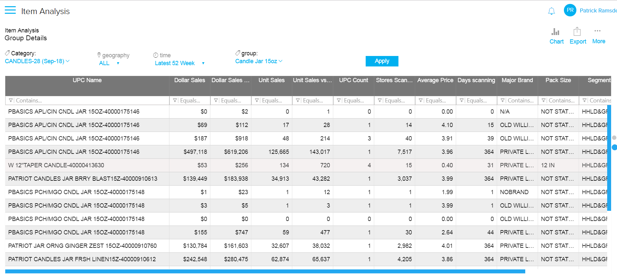
Use Case of a high-level decision tree: Candles Chart view and Grid view
Default view is Chart; click on “Grid” for details with sales metrics
1a. Grid: the top displays total group metrics
1b. Grid: the bottom displays metrics of each UPC in the group; based on which group the cursor is placed
2. Click on “Chart” to navigate back to Dendrogram chart

Slide 14
Use Case of a high-level decision tree: Candles
Reviewing the chart product groupings…
Evaluate the significant product groupings to understand customer need states, functional groups and Merchandising insights
Insight: The Candle Jar 15oz item group remains the same all the way down the tree indicating strong switching within the group; yet strong differentiation vs. other groups on the shelf.
Recommendation: Merchandise these items all in one place on the shelf for ease of shopping this important need state.
Insight: Tea lights, Pillars and Religious candles break out together, indicating they are purchased by the same customer over time
Recommendation: Merchandise these in a block to help build the basket by increasing purchases of different kinds of candles

Slide 15
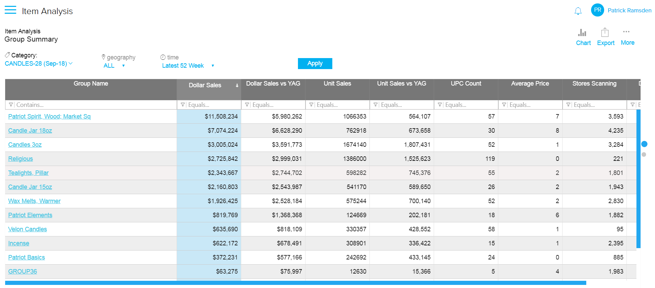
Macro Customer Decision Tree in Unify = Item Analysis Reports Use Case high-level decision tree: Candles
Export the grid view in order to evaluate the named groupings for dollar contribution to the shelf, year over year performance and meeting customer needs.
Use UPC output to run analysis (e.g., Loyalty, Switching, Exclusivity, Purchase Cycle) on item groups not reported at a standard hierarchy level
Insight: Tea Lights and Wax Melts are at the same level of the item analysis, yet Tea Lights generate nearly twice as much dollars with almost the same amount of UPCs.
Recommendation: Understand item velocity and/or incrementality when deciding on one more facing of Tea Lights vs. Wax Melts.

